Slide 1

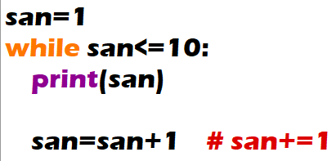
Print the numbers from 1 to 10.

Slide 2

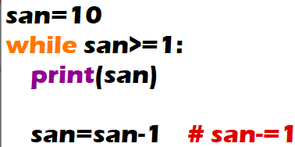
Print the numbers from 10 to 1.

Slide 3
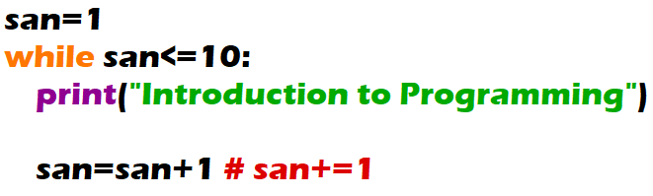
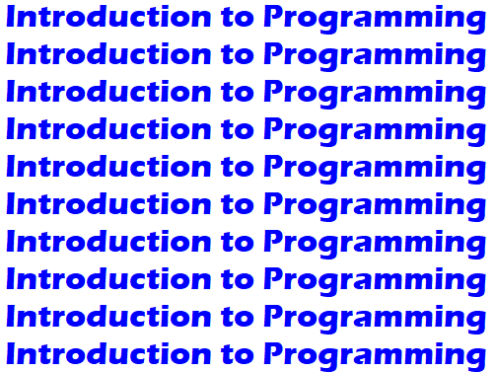
Print the “Introduction to Programming” 10 times.

Slide 4
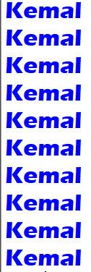
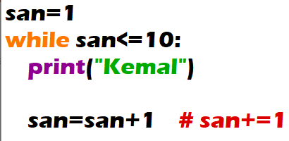
Print the numbers from 1 to 10.

Slide 5

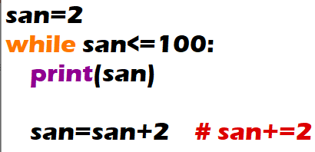
Output the even numbers from 1 to 100.

Slide 6

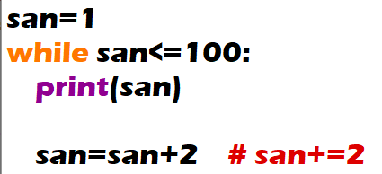
Output the odd numbers from 1 to 100.

Slide 7

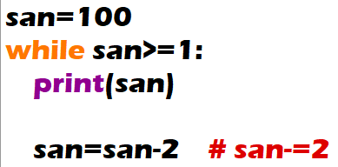
Output the even numbers from 100 to 1.

Slide 8

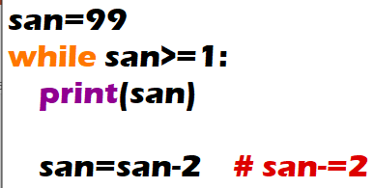
Output the odd numbers from 100 to 1.

Slide 9
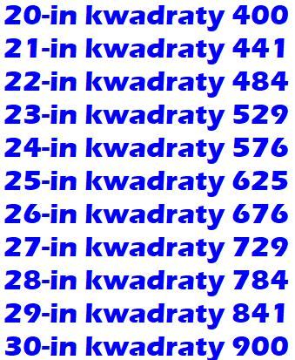
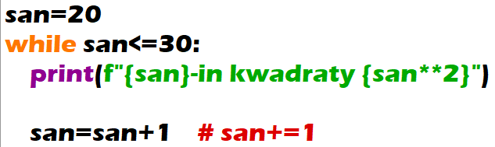
Find the square of numbers from 20 to 30.

Slide 10
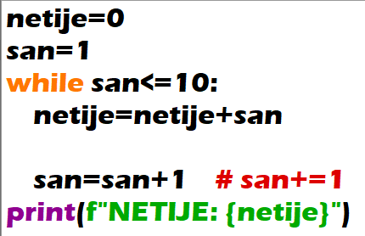

Find the sum of numbers from 1 to 10 (1+2+3+...+9+10).

Slide 11
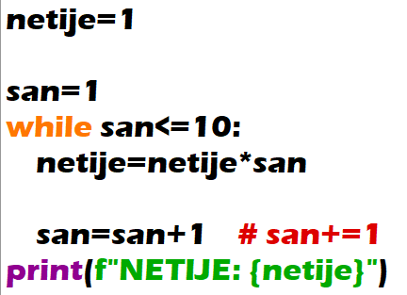

Find the multiplication of numbers from 1 to 10 (1*2*3*...*9*10).

